Slide 1
Git Assignment
Koustav Mukherjee

Slide 2

1.How can you initialize a repository in Git? Write Command.
Using the git init we can initialize a repository in git.
Command:- git init [repository name]

Slide 3
2.Create repository named - Employee . After that create branch named - Employee_Detai
At first go to our github account and log in
Go to Create a new repository
After that give a name of the repository Employee and set it public or private then select read me file create repository
After creating repository we have copy the link and then use the git clone <use copy link>
After that we go to the employee repository that locally available on our pc
Then we create a branch that name “ Employee_Detai
Use the git branch <branch name> command .
Use the git branch commend and see the branch is exist

Slide 4
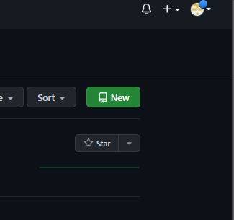
Go to Create a new repository

Slide 5
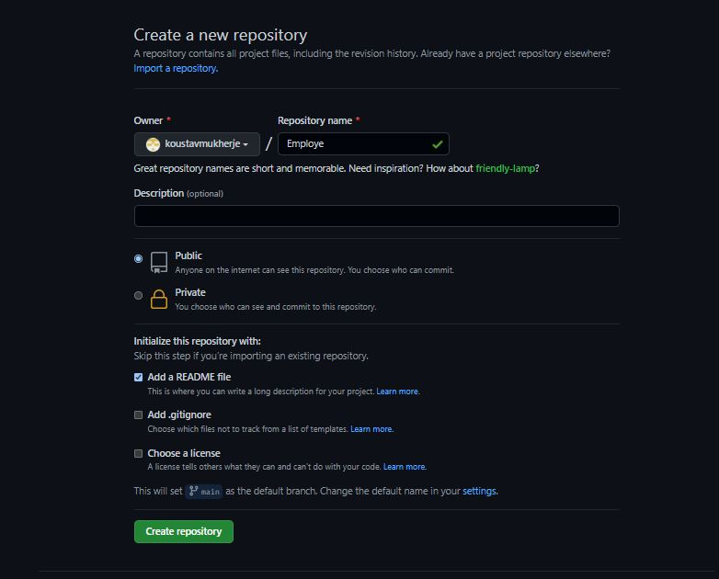
Create the repository

Slide 6
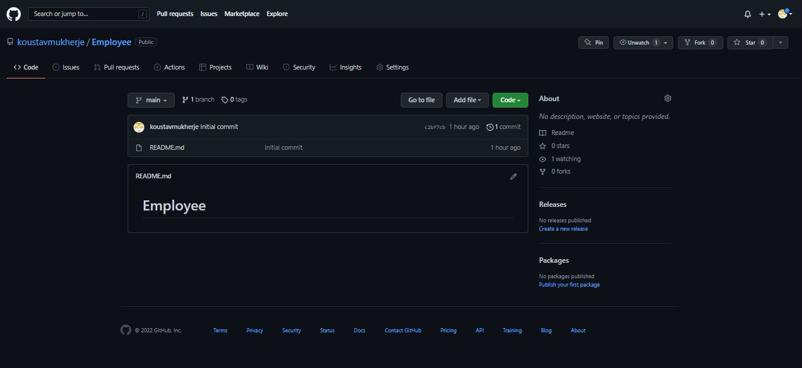
Create the employee repository then we go to code section and copy the link

Slide 7
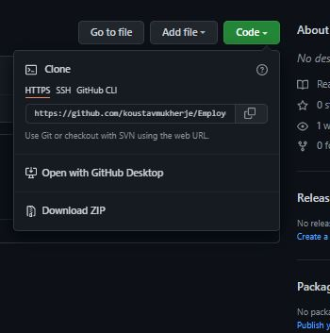
For cloning we copy the git url link

Slide 8
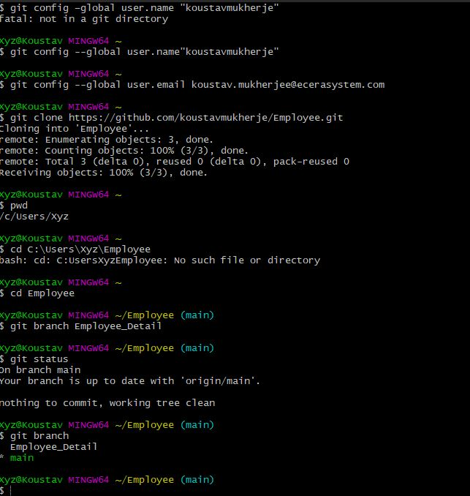
Here we create the branch employe_Ditail

Slide 9
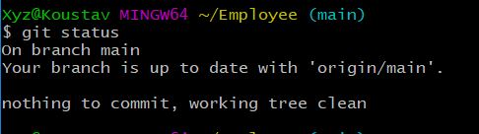
3.In Employee repository check the status and later commit new file or folder in it.
After that we go our local repository Employee and check the status using git status commend.

Slide 10
Cont.
After that put some file in Employee repository and then use get console and again use git status it shows us that some file are modified ,and add thus file .
After that we use git add “file name ” or use git add * anyone commend to add thous file.
After that use git commit to committed the file by git commit –m “add commit massage”.

Slide 11
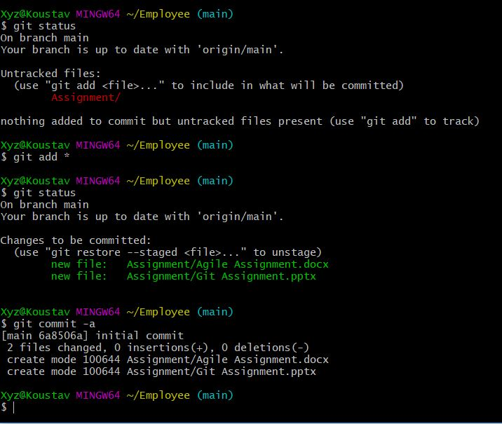
Cont.

Slide 12
4.Merge two branch in Employee repository .
In Employee there are two branch one is Main branch and another is Employe_Ditail
Using git branch commend we can see that how much branch is there and in which branch we are right now.
Then go to any of branch using git checkout <branch name> command and in main or either Employe_Ditail and change the document and again use git status and add and commit the changes.
Then use git push command to push the file to origin of git-hub. And switch to another branch Employe_Ditail.
After that use git merge to merge the two branches changes.
Command :- Git merge <branch name>

Slide 13
Cont.
After that merge compete then we push the changes to origin using git push origin <branch name>.

Slide 14
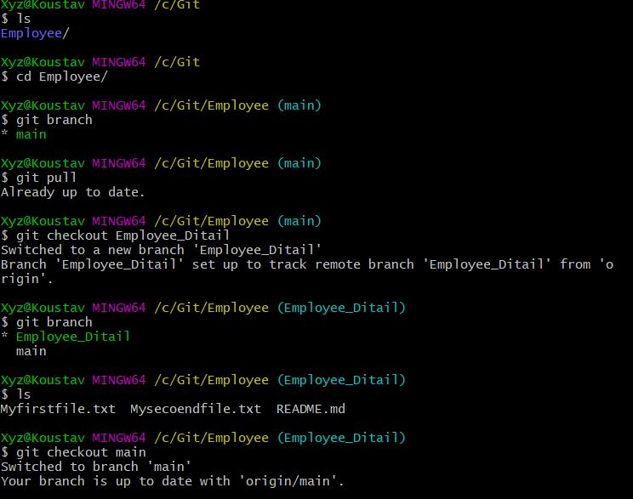
Process merge in Details

Slide 15
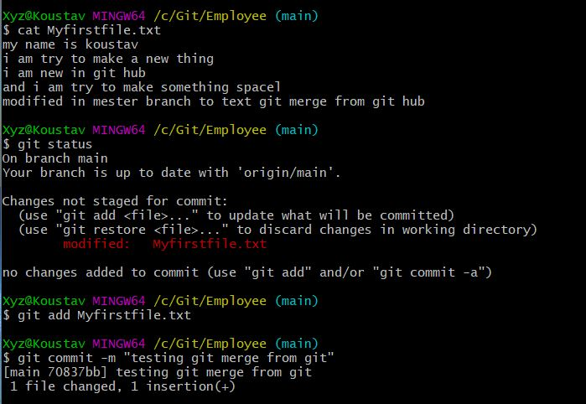
Process merge in Details

Slide 16
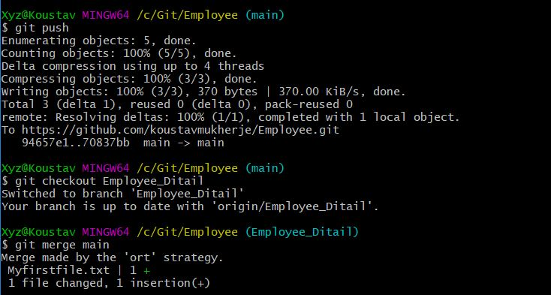
Process merge in Details

Slide 17
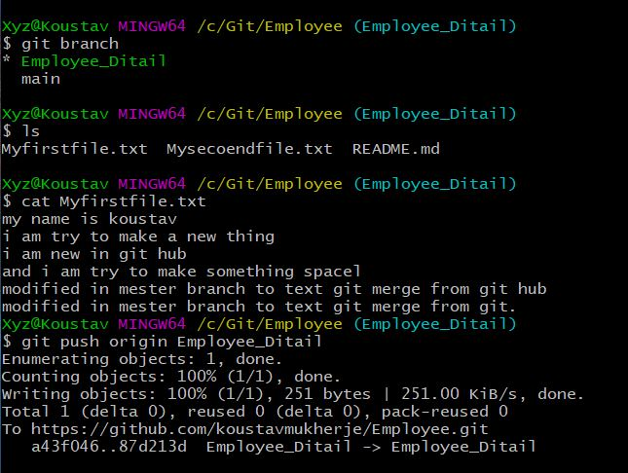
Process merge in Details

